Slide 1
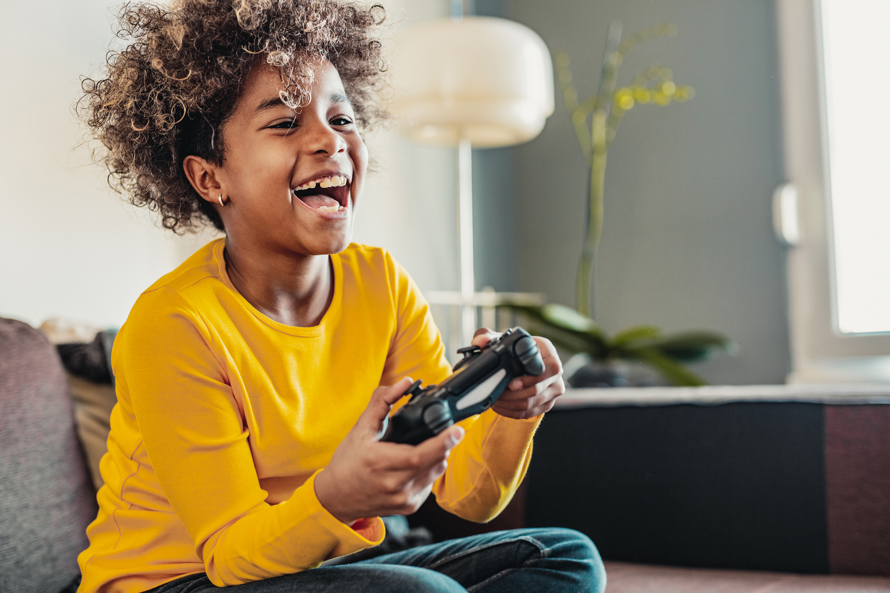

Gaming and Gamification boon or bane?
- Madhavi Ghanta
DSC 500 Bellevue University, Masters of Data Science

Slide 2
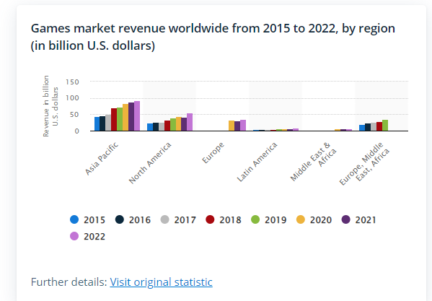
Gamers market on rise
Playing video games can be pleasurable and fun for many people, for others it can develop into a bad habit.

Slide 3

Disadvantages of playing Video games
Tiredness
Violent games can sometimes make people do things they normally wouldn’t do. Such as going on a killing spree, thinking they’re playing a game.
Damages eyesight, and causes dizziness
Headaches and migraines
Carpal tunnel syndrome
Become lazy and unfit
(Gaming Addiction Statistics 2020)

Slide 4
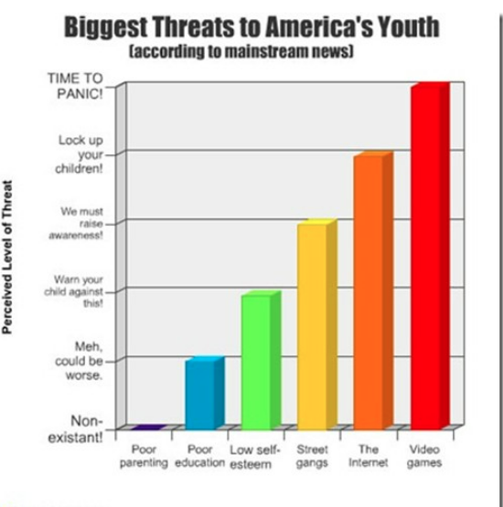
Video Game Addiction and Co-Occurring Disorders
Depression
ADHD
Autism

Slide 5
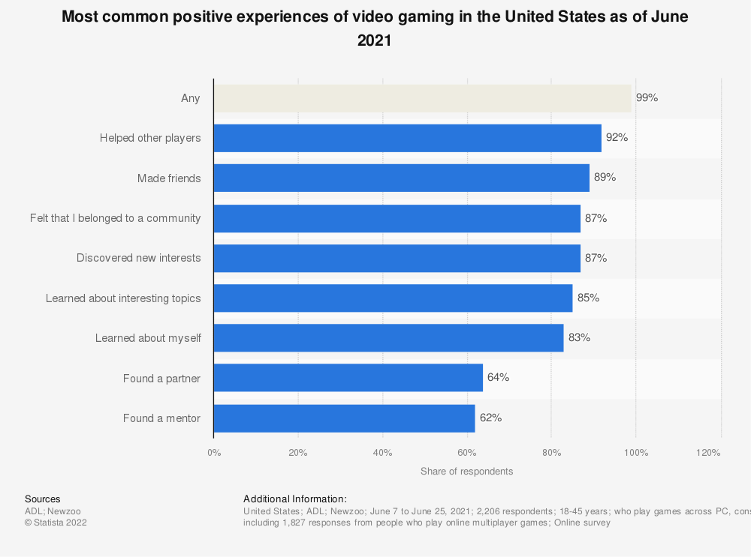
Advantages of playing Video games
enhanced mental capacity
enhanced logical and problem-solving abilities
improved eye-hand coordination
greater capacity for multitasking
more rapid and precise decision-making
improved prosocial conduct

Slide 6
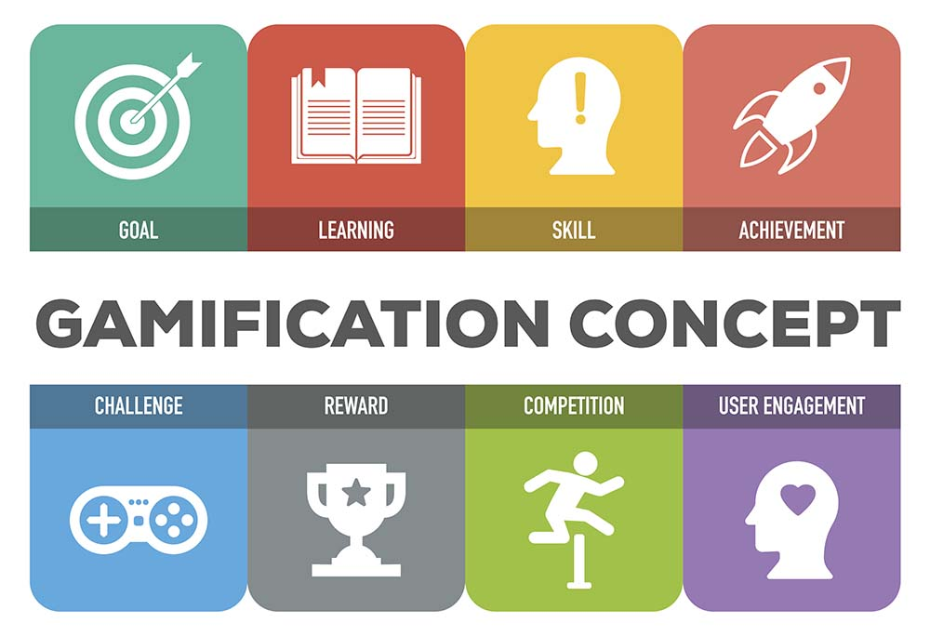
What is Gamification?
Gamification is the application of gameful or playful layers to motivate engagement with a specific context

Slide 7
Gamification Advantages
Aids in cognitive development in adolescents.
Physical development - Exercising with an interactive game
Gamification increases the level of engagement in classrooms.
Gamification aids in accessibility in the classroom.
Gives learners the opportunity to see real-world applications
Gamification Apps Examples:
Code School
Duolingo
ClassDojo
Prodigy

Slide 8
Addictive Games – Ethical Concerns
Is it ethical to create games that have the sole purpose of keeping users playing and spending for as long or as much as possible?
What are the dangers of allowing firms to combine data mining with addictive game features and, potentially, personalized gaming experiences?
What are the harms (economic vs societal vs personal)?
Exploitation and manipulation are the two basic criticisms made of gamification.
Should we introduce regulations, and if so, how?
(The Compulsion Loop in Game Design Explained 2021)

Slide 9
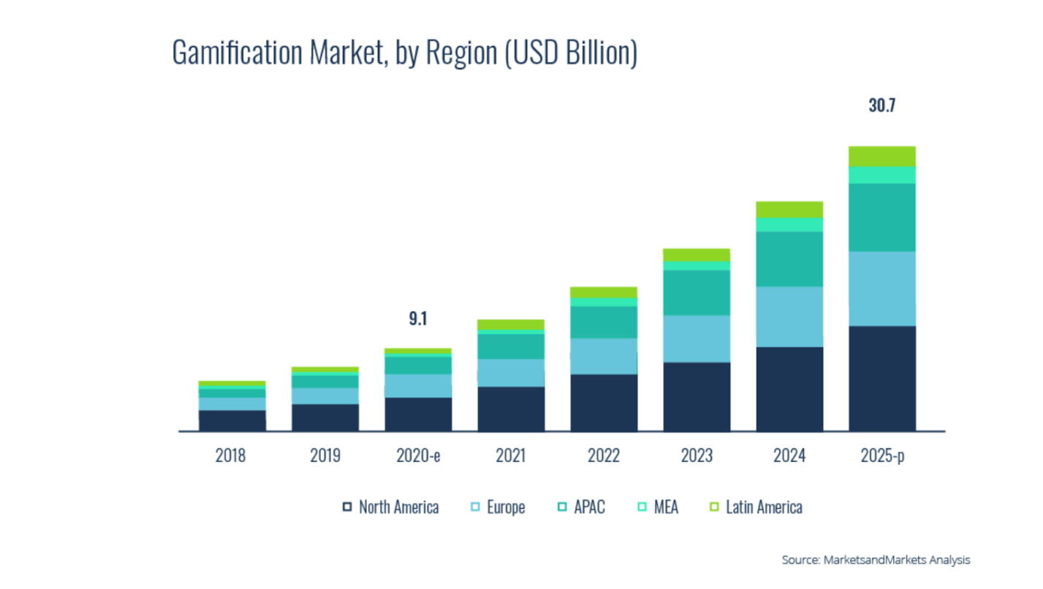
Opportunities
For the next five years, North America will continue to hold the biggest market share for gamification worldwide.
With 90% of citizens owning a smartphone, the region's high percentage of mobile internet users will be the driving force behind this.

Slide 10
Conclusion
Playing online games sensibly in moderation may be beneficial and a good source of education and fun. Keeping a healthy balance is crucial in both real life and online gaming.
Online gaming addiction and serious health problems might result from losing your equilibrium, which can transform the activity into a problem.

Slide 11
References
About Joseph Kim Mobile game philosopher and entrepreneur. Watch my game dev relaated videos at GameMakers on YouTube and listen to my podcast on Deconstructor of Fun. View all posts by Joseph Kim. (2020, June 27). The Compulsion Loop in Game Design Explained. Retrieved October 11, 2020, from https://gamemakers.com/the-compulsion-loop-explained/ (
Gaming Addiction Statistics. (2020, January 28). Retrieved October 11, 2020, from https://www.therecoveryvillage.com/process-addiction/video-game-addiction/related/gaming-addiction-statistics/
Gamification as a tool for engaging student learning: A field experiment with a gamified app - Kasper Welbers, Elly A Konijn, Christian Burgers, Anna Bij de Vaate, Allison Eden, Britta C Brugman, 2019 (sagepub.com)
https://www.growthengineering.co.uk/19-gamification-trends-for-2022-2025-top-stats-facts-examples/
Griffiths, Mark. (1995). Technological addictions. Clinical Psychology Forum. 76. 14-19. https://www.researchgate.net/publication/284665745_Technological_addictions
https://www.enterpriseappstoday.com/stats/gamification-statistics.html

